Slide 1
K – Means Clustering

Slide 2
K-means clustering is a popular unsupervised machine learning algorithm used for clustering data points into a predefined number of clusters, represented by 'k'. Here's how it works:
1. Initialization: Choose 'k' initial centroids (points) randomly from the dataset.
2. Assignment: Assign each data point to the nearest centroid, forming 'k' clusters.
3. Update: Recalculate the centroids as the mean of all data points assigned to each centroid.
4. Repeat: Repeat steps 2 and 3 until convergence (when centroids don't change much between iterations) or for a specified number of iterations.

Slide 3
The algorithm aims to minimize the sum of squared distances between data points and their respective centroids. However, the solution may not always be globally optimal and can depend on the initial centroid selection.
It's important to note that the choice of 'k' and the initialization of centroids can significantly affect the clustering result. Various techniques, such as the elbow method or silhouette analysis, can help determine the optimal number of clusters 'k'.

Slide 4
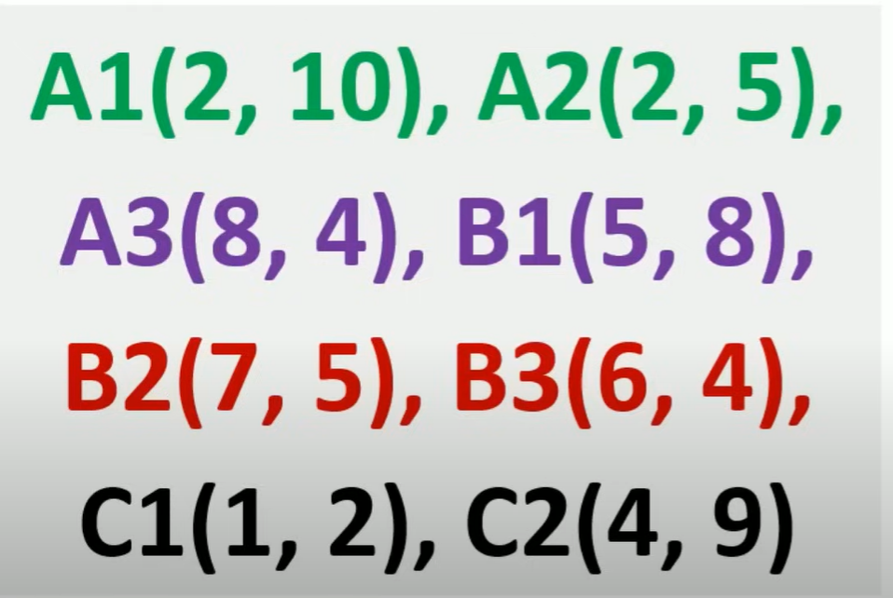
Solved Example

Slide 5
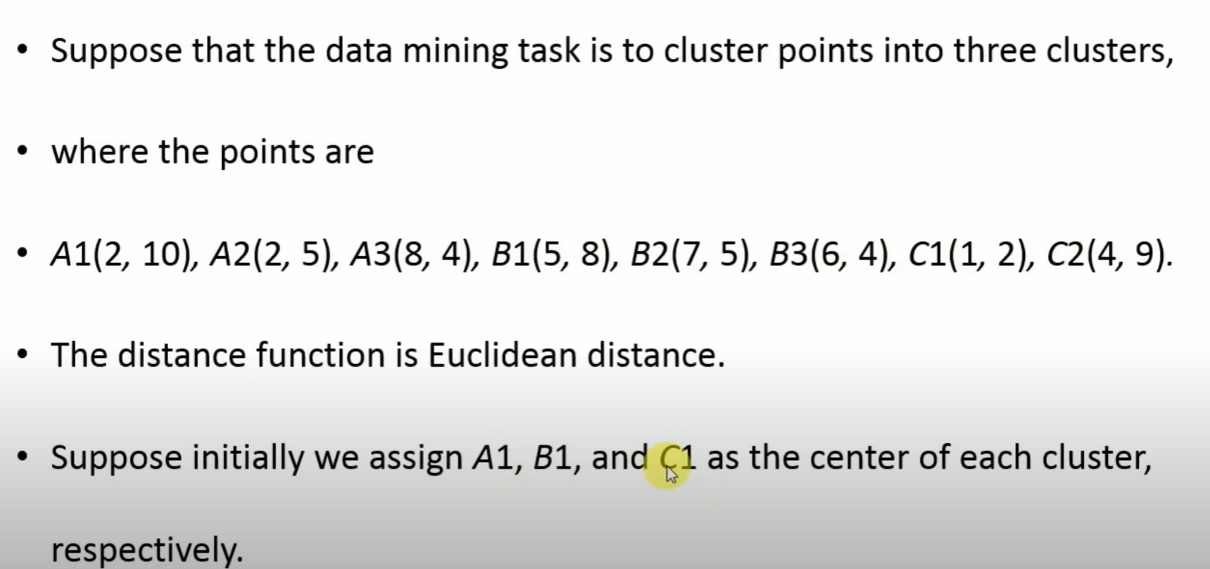

Slide 6
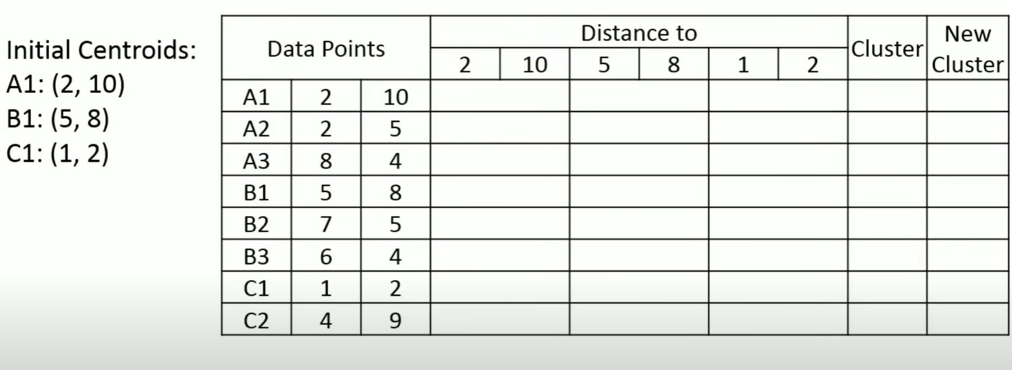
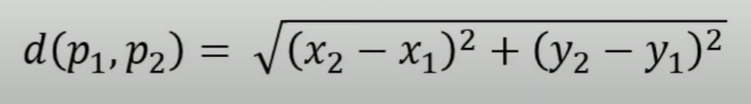

Slide 7
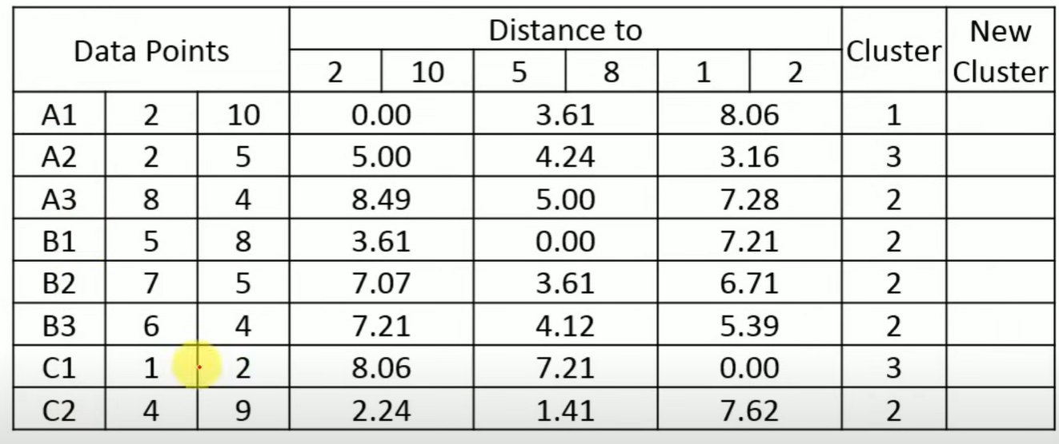

Slide 8
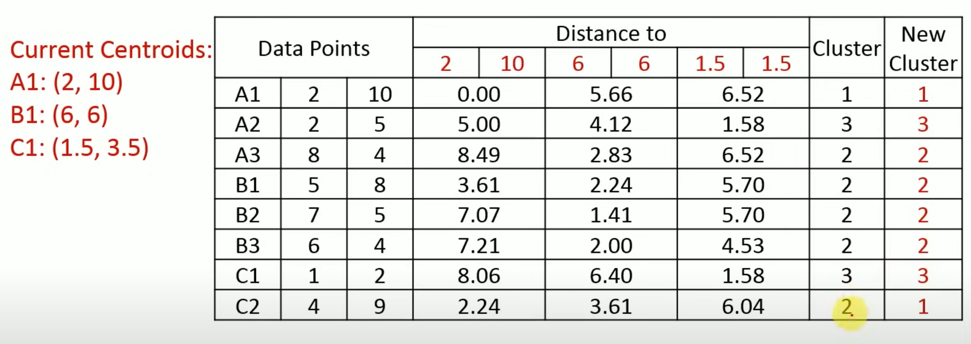

Slide 9
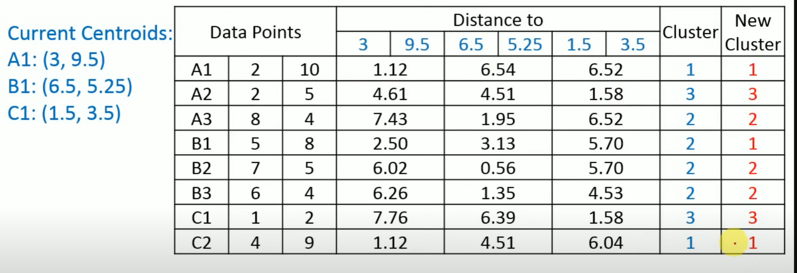

Slide 10
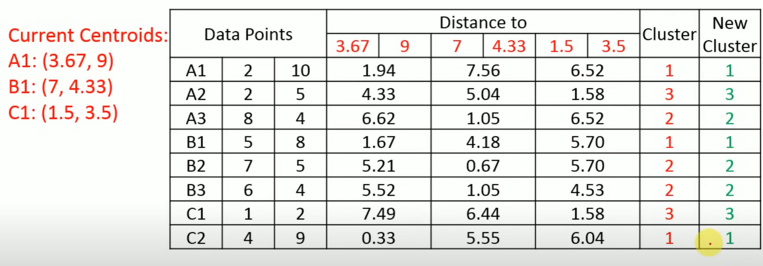

Slide 11
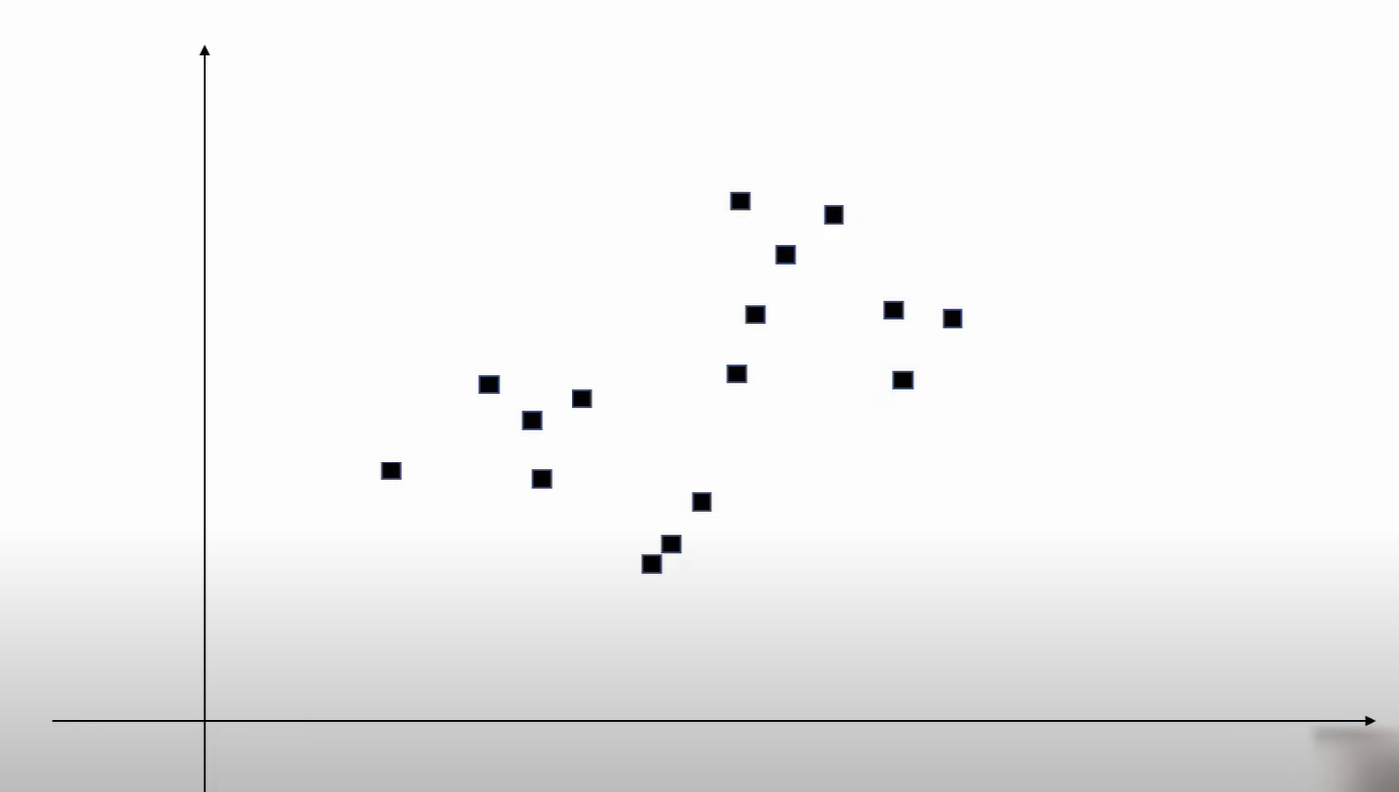

Slide 12
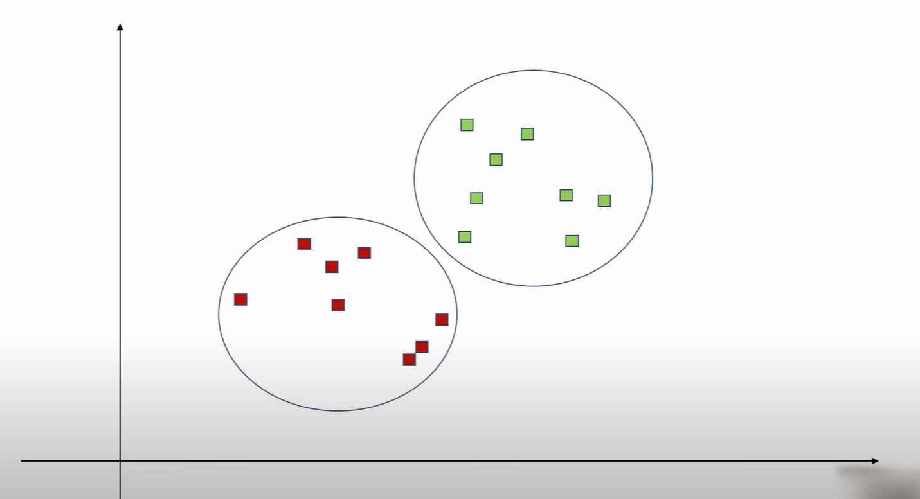

Slide 13
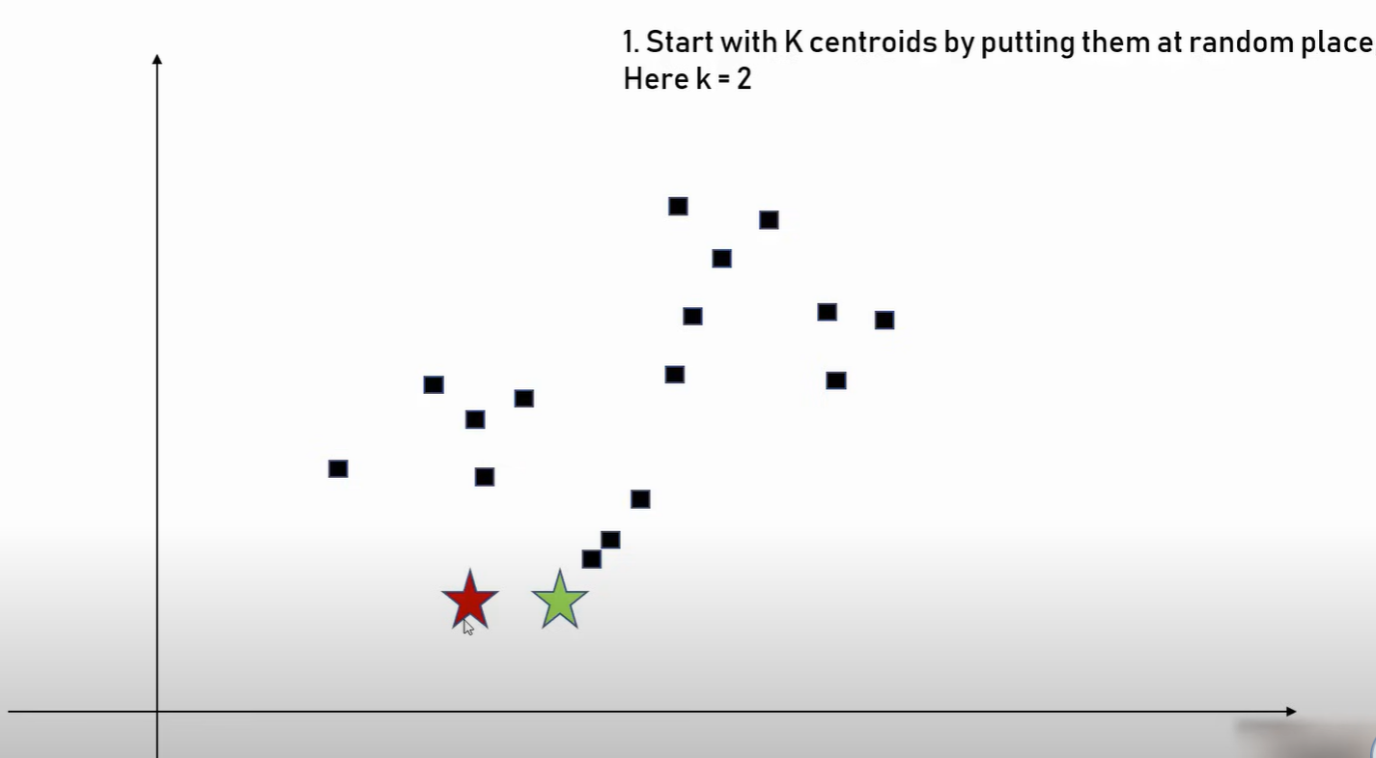

Slide 14
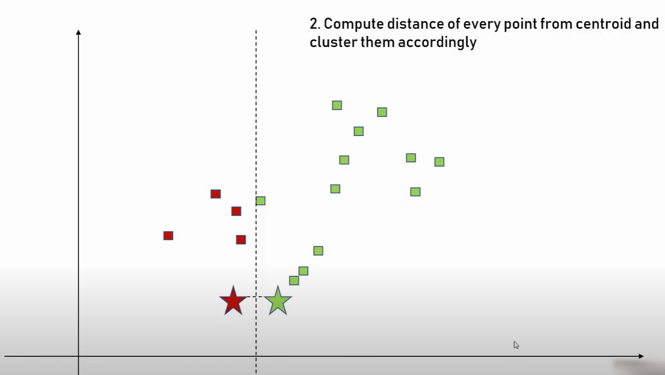

Slide 15
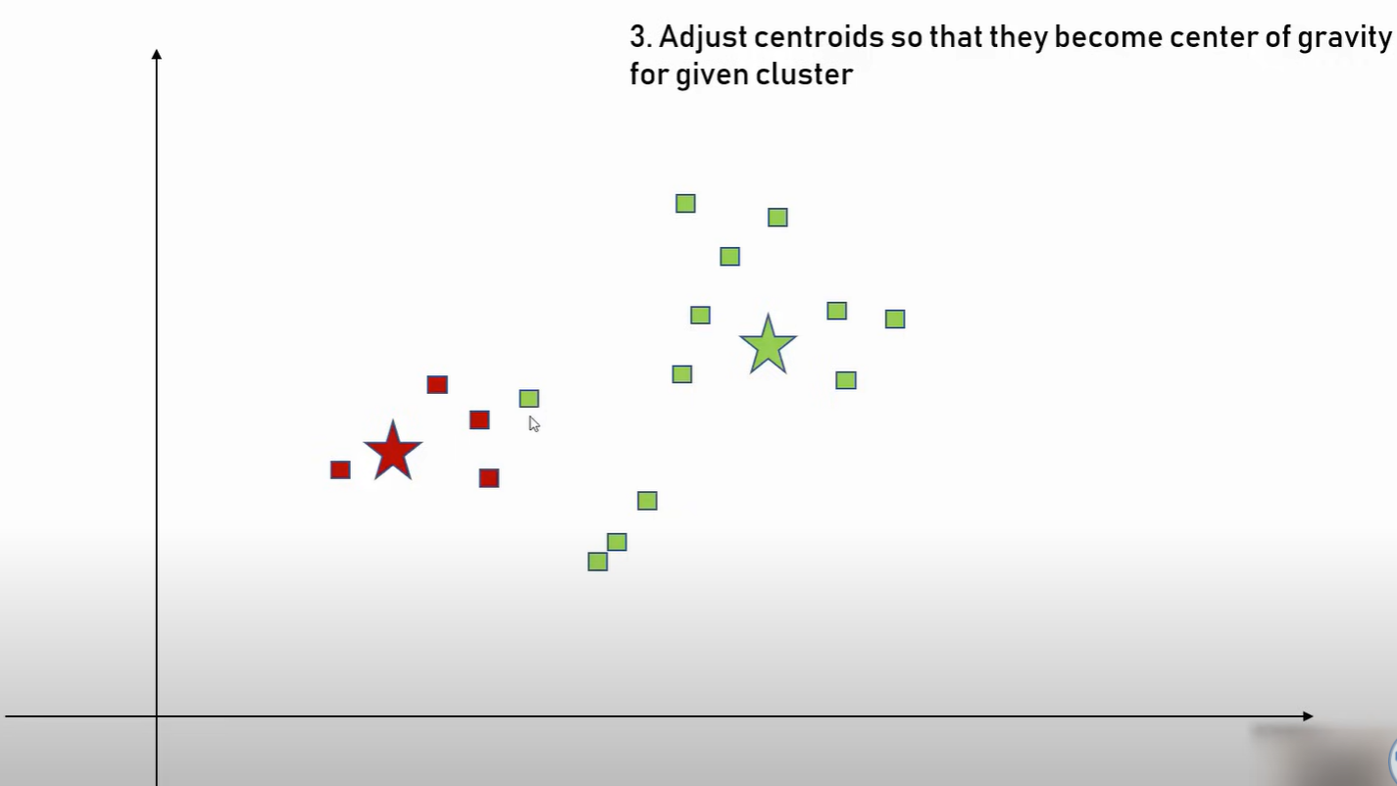

Slide 16
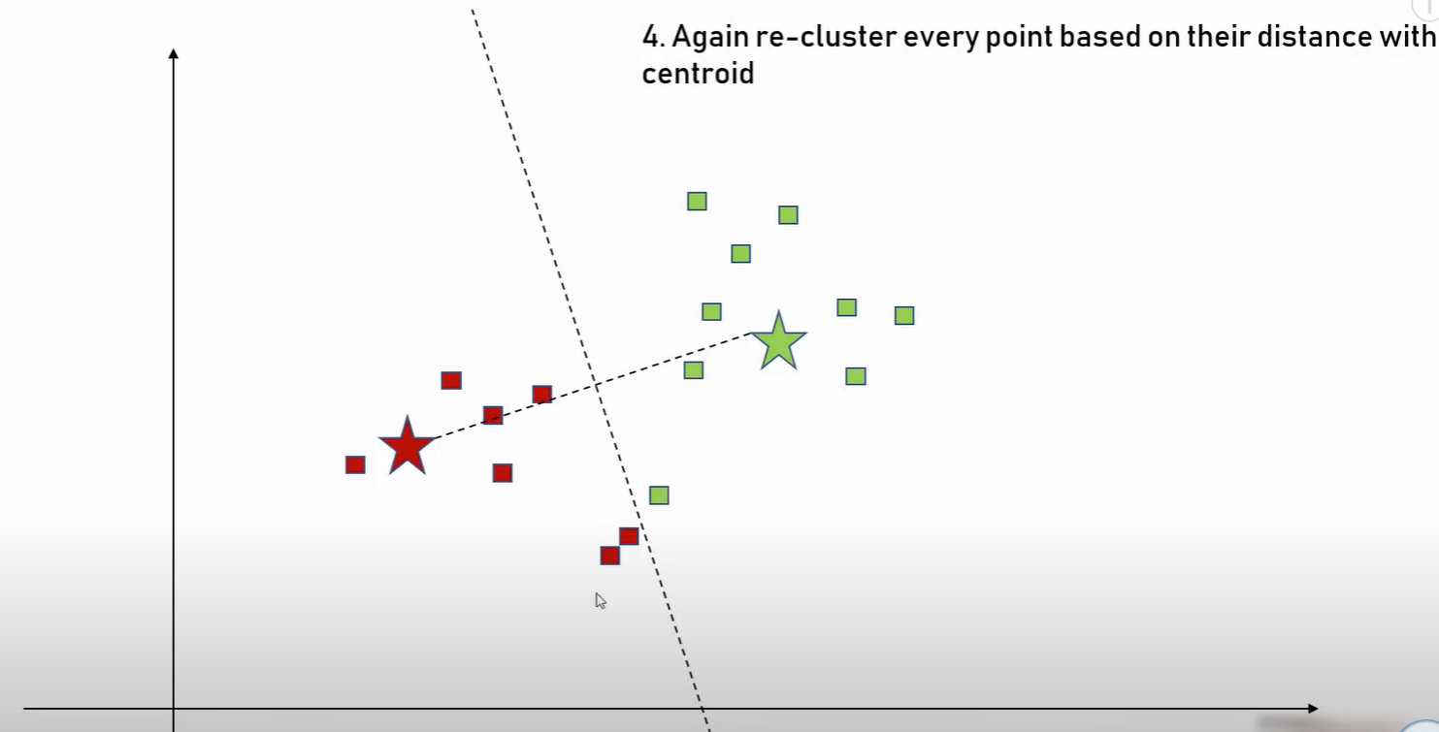

Slide 17
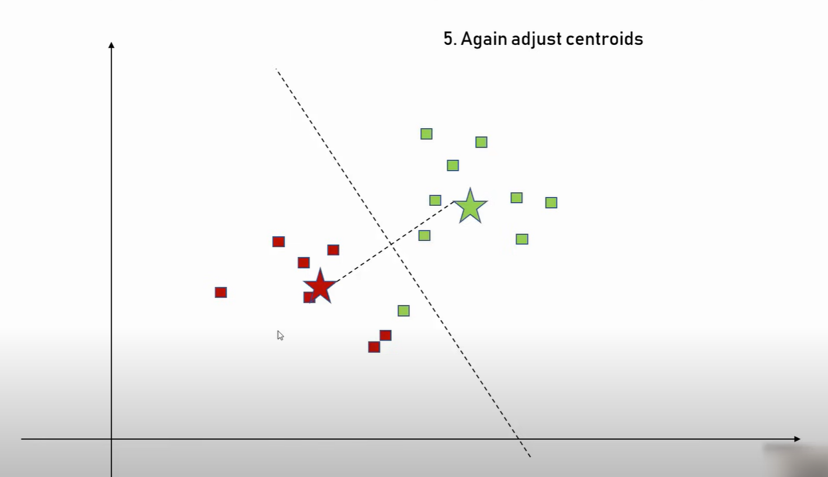

Slide 18
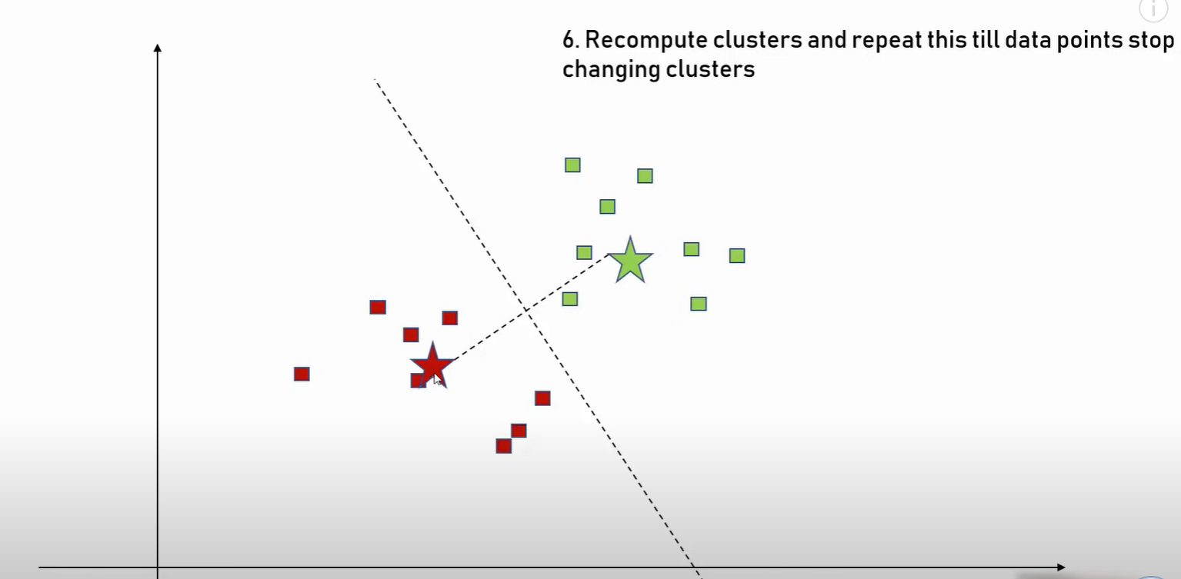

Slide 19
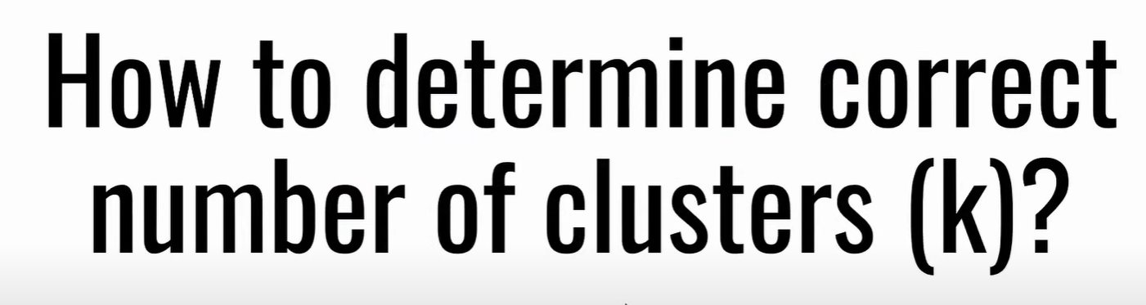

Slide 20
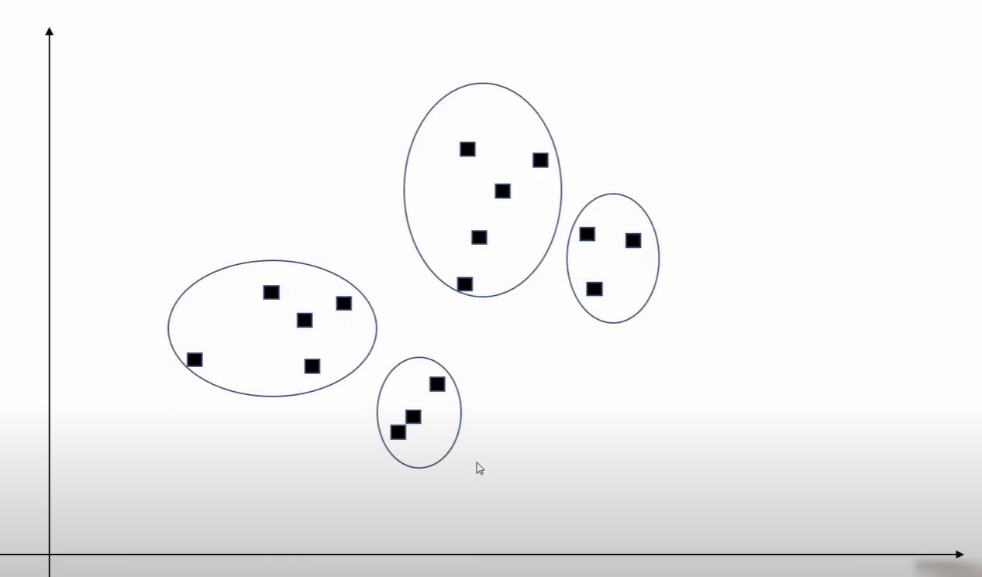
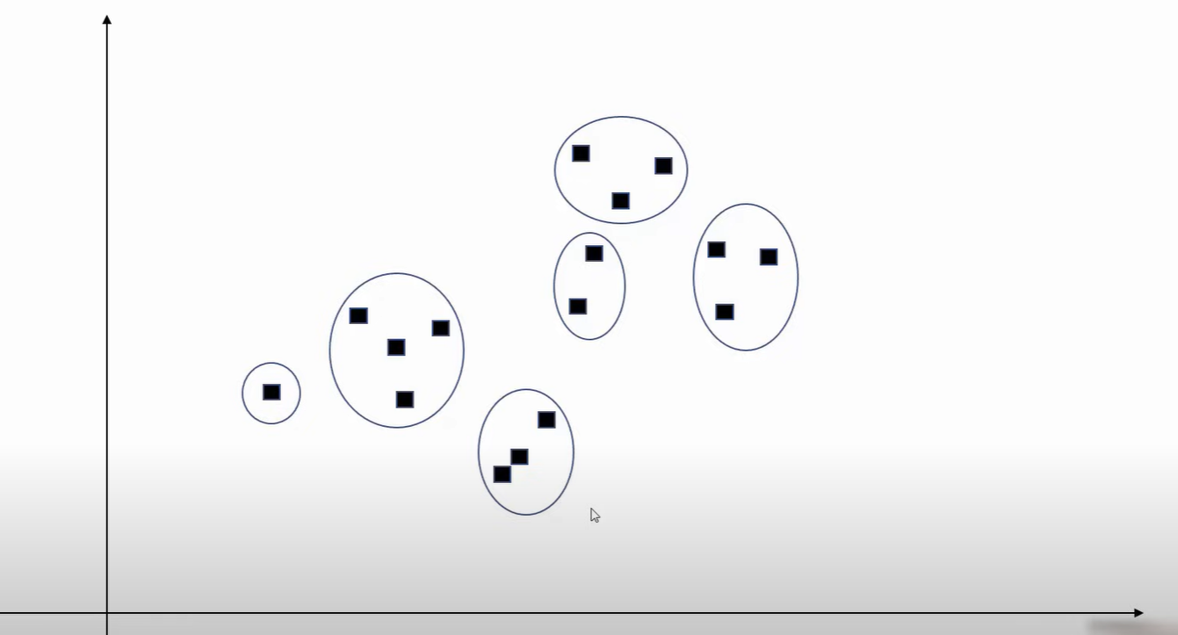

Slide 21
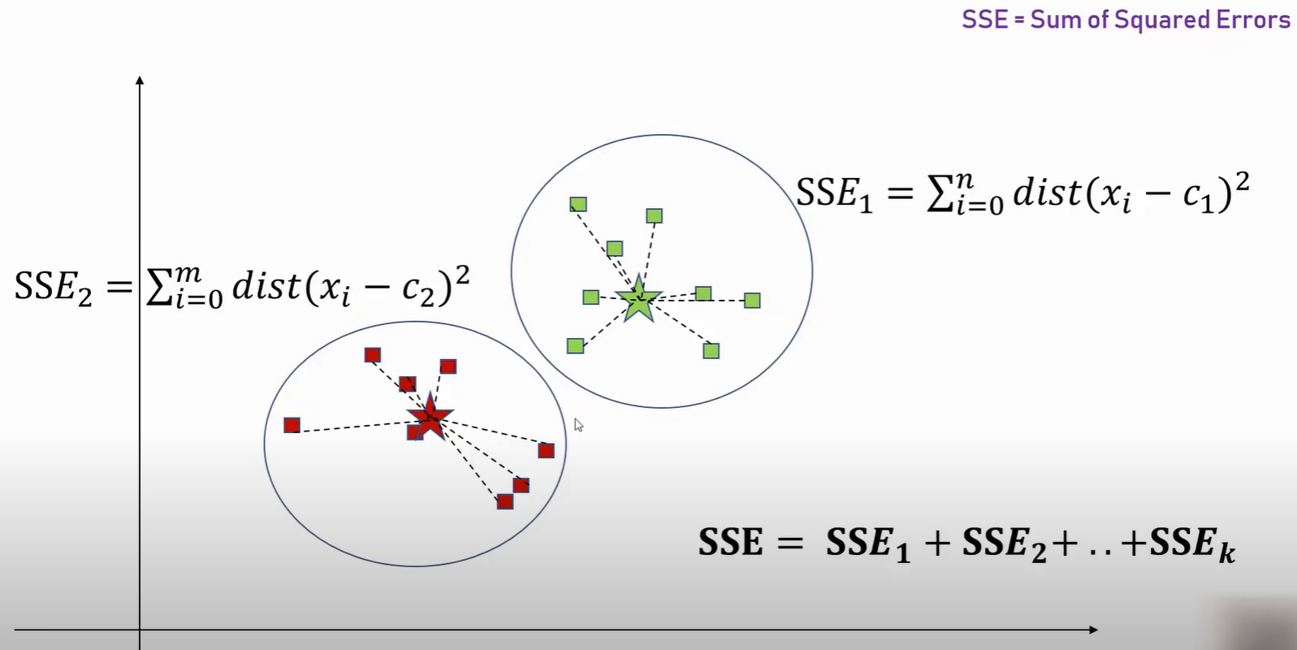

Slide 22
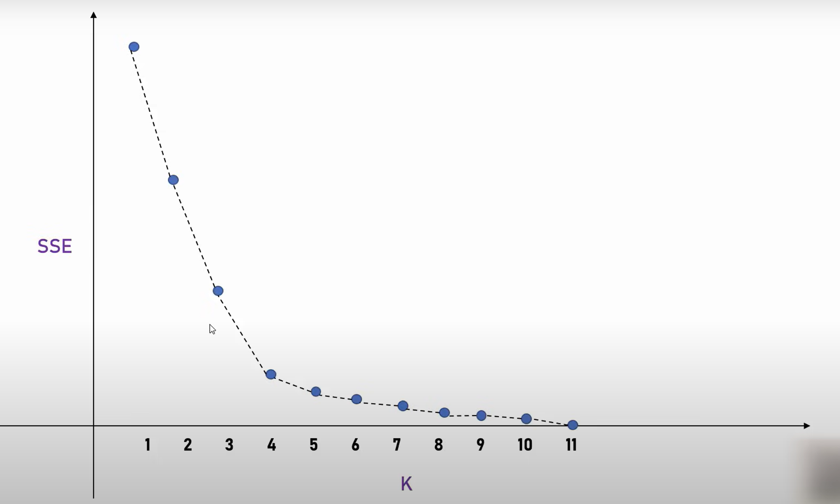

Slide 23
